Slide 1
MSSP 608: Practical Machine Learning Methods Week 5
1

Slide 2
Reading
https://towardsdatascience.com/understanding-8-types-of-cross-validation-80c935a4976d
**There are 8 different cross-validations – we focus on 3***

Slide 3
House Keeping
Quiz due tomorrow (before midnight)
Please post any questions for quizzes 1-3 on google doc – directions in class email (due tomorrow before midnight)
Homework 1 is due 2/21 at 11:59 p.m. EST
Please direct questions to Piazza
“cheat sheet” posted on Canvas
TA office hours for further help

Slide 4
Assignment 1
Decision Trees
Train/test split
Model Performance Metrics
Preprocessing (required for each assignment)

Slide 5
Assignment 2
Decision Trees vs. logistic regression
Train/test split
Model Performance Metrics
Preprocessing (required for each assignment)
Hyperparameter tuning
K-fold or stratification strategy for cross-validation

Slide 6
Road Map…
Prior weeks
This week
Coming weeks
Validation | ML Algorithms
 | Supervised | Unsupervised | Reinforcement
 | Decision trees | Prin. Comp. Anal. (PCA)
Test/train (hold out cross validation) | Linear regression | K-means
K-fold cross-validation | Logistic regression | Hierarchical clustering
Stratified cross-validation
Hyperparameter tuning (ridge, lasso, elastic net regression) | Naïve Bayes
 | Random Forests
 | Gradient Boosting
 | SVM algorithm
 | kNN

Slide 7
Quiz #3 class average – 91%
7

Slide 8
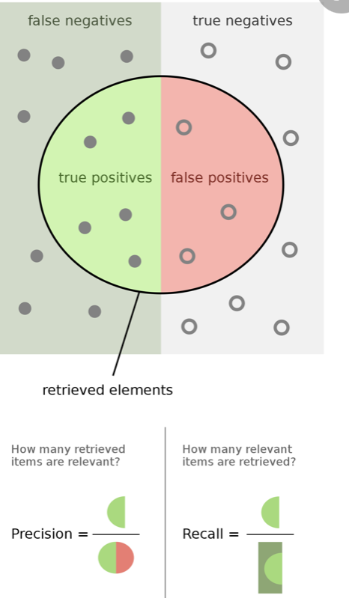
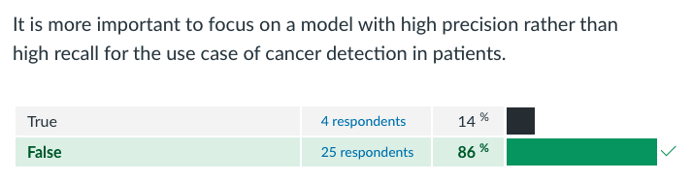
Quiz 3 (1)

Slide 9
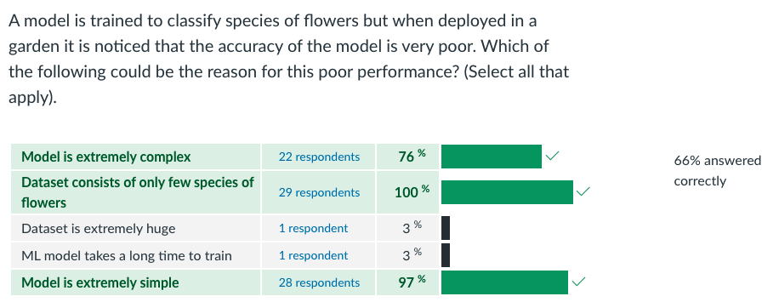
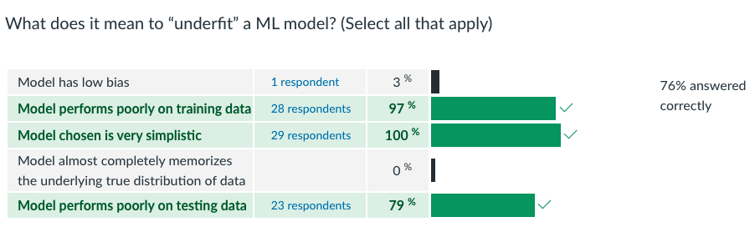
Quiz 3 (2)

Slide 10
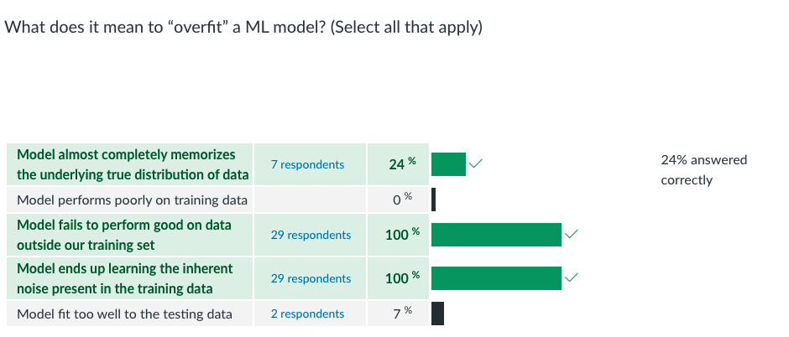
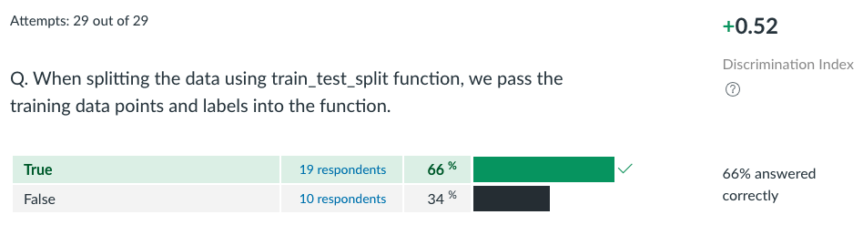
Quiz 3 (3)

Slide 11
Quiz responses (1):
Question 6 | TRUE | forgot the definition of "features"
Question 15 | FALSE | When I saw the title, I thought of the training set and the testing set. I thought "the data it learns from" refers to the training set. The model needs to be powerful not only on the training set, but also on the testing data, so I chose false. | Echo with it, talked in class last time, but the question framing is not quite appropriate
Question 7 | FALSE | I think the action of only splitting data into training and testing sets is not gonna help combat model overfitting. What is going to help is the training with training data set and testing. I think only splitting is not going to help. Key is to train and test with different data sets.

Slide 12
Quiz responses (2):
Question 5 | False | Maximize per leaf purity might lead to a decision tree model being too complicated and over-fitting. Describing the aim as simple and as definitive as this seems wrong or at least tricky in a T/F question.
Question 11 | 3 Correct answers + ML model takes a long time to train | Was thinking about adjusting and tuning the model as part of the training, so it could take a long time for the model to work in a real-world scenario

Slide 13
Review (logistic/linear regression)
13

Slide 14
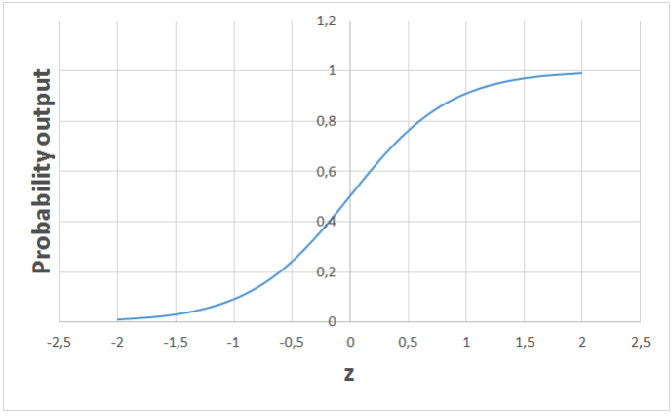
Logistic Regression
Supervised learning algorithm
Binary classification problems (0 or 1 – e.g., pass or fail, healthy or sick)
High bias / low variance
Takes in any real valued number and maps it to a value between 0 and 1

Slide 15
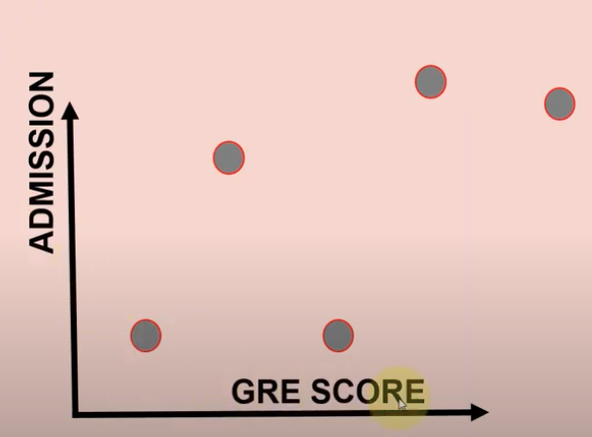
Linear Regression
Supervised learning algorithm
Assumes a linear relationship
High bias / low variance

Slide 16
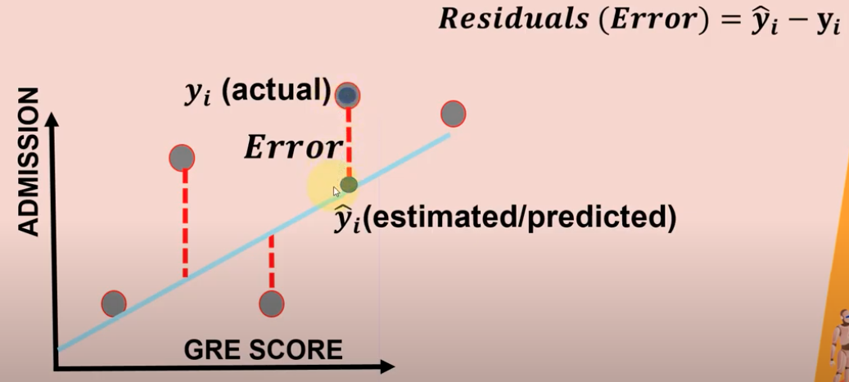
Key metrics
Mean Absolute Error (MAE)
Mean Squared Error (MSE)
Root Mean Squared Error (RMSE)
Coefficient of determination (R squared)

Slide 17
Objectives
Cross-validation
Holdout cross-validation
k-fold cross-validation
Stratified k-fold cross-validation
Hyperparameters
Ridge (L1), Lasso (L2), and Elastic Net

Slide 18
Cross-validation https://www.youtube.com/watch?v=fSytzGwwBVw https://www.youtube.com/watch?v=zSbD__Ip6Mo
18

Slide 19
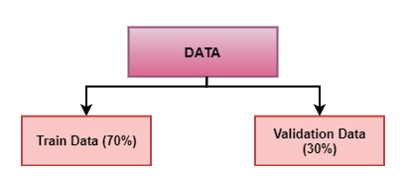
Holdout Cross-Validation
Pros:
Simple, easy to understand, and implement
Cons:
Not suitable for an imbalanced dataset
A lot of data is isolated from training the model

Slide 20
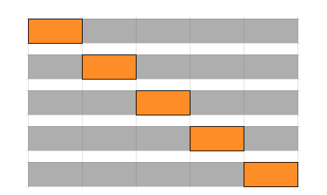
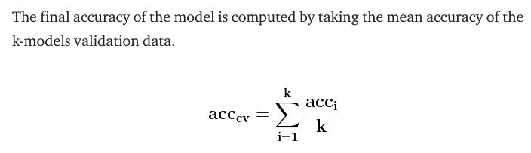
k-fold Cross-Validation
In k-fold cross-validation, the original dataset is equally partitioned into k subparts or folds.
Out of the k-folds or groups, for each iteration, one group is selected as validation data, and the remaining (k-1) groups are selected as training data.
Pros:
The model has low bias
Low time complexity
The entire dataset is utilized for both training and validation.
Cons:
Not suitable for an imbalanced dataset

Slide 21
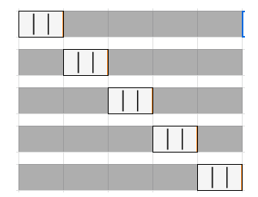
Stratified k-fold Cross-Validation
Prior cross-validation methods do not work well with an imbalanced dataset.
Stratified k-fold cross-validation solves this problem
How?
Partitions dataset into k groups or folds such that the validation data has an equal number of instances of target class label.
This ensures that one class is not overrepresented in the validation or train data
Pros:
Works well for an imbalanced dataset.
Cons:
Not suitable for time series data (read up on time series cross-validation)

Slide 22
What does this look like in Python?
Hold out cross validation:
***see prior weeks code***
k-fold cross validation:
# import packages
from sklearn.model_selection import KFold
from sklearn.model_selection import cross_val_score
from sklearn.linear_model import LogisticRegression
# prepare the cross-validation procedure
cv = KFold(n_splits=10, random_state=1, shuffle=True)
# create model
model = LogisticRegression()
# evaluate model
scores = cross_val_score(model, X, y, scoring='accuracy', cv=cv, n_jobs=-1)
# report performance
print('Accuracy: %.3f (%.3f)' % (mean(scores), std(scores)))
Stratified k-fold cross validation:
***watch asynchronous learning***

Slide 23
Hyperparameter tuning
23

Slide 24
Parameter vs. hyperparameter
Parameters are estimated from the dataset. They are part of the model equation.
Hyperparameters are set manually to help in the estimation of the model parameters. They are not part of the final model equation.
Examples of hyperparameters in logistic regression
1. Learning rate (α). One way of training a logistic regression model is with gradient descent. The learning rate (α) is an important part of the gradient descent algorithm. It determines by how much parameter theta changes with each iteration.
2. Regularization parameter (λ). The regularization parameter (λ), is a constant in the “penalty” term added to the cost function. Adding this penalty to the cost function is called regularization. There are two types of regularization — L1 and L2. They differ in the equation for penalty.
In training a model, the model is supposed to find a weight for each feature. Each weight is a value in the vector theta. Because there’s now a penalty on having a weight for a feature, it incentivizes the model to move weights closer to 0 for some features. Therefore, regularization minimizes the complexity of a model to avoid overfitting.

Slide 25
Parameter vs. hyperparameter
The goal of regularization is to prevent model overfitting (λ)
Lasso (L1)
Ridge (L2)
Elastic Net (combines L1 and L2)
Weight = B0 + B1*height + B2*activity + B3*muscle_mass + B4*gender + 2000 more variables
B1 for height = 0 0 * 200 pounds = 0
5 to 0.001 - 5 * 200 = 1,000
0.001 * 200 = 0.2
All three methods minimizes the impact of a predictor variable.
Limitation:
These approaches reduce the complexity of the model but DO NOT reduce the number of variables.

